Slide 1
Hvordan gik det med øvelserne?
order by
aggregat-funktioner (count, min, max, avg)
group by
Notes:
select count(*) from emp group by deptno having count(*) > 4
select count(*) from emp group by deptno having deptno > 20
select round(avg(sal),1) from emp
Distinct → select job from emp group by job

Slide 2
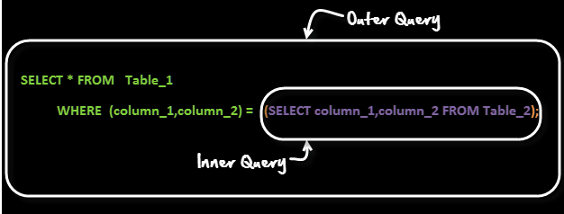
SQL subquery
En subquery er en select query indeni en anden select query.
Den indre select query bruges typisk til at bestemme resultatet af den yderste query
Notes:
https://www.guru99.com/sub-queries.html

Slide 3
SQL subquery eksempel
SELECT ename FROM EMP
WHERE deptno =
(SELECT deptno FROM dept
WHERE loc = 'DALLAS')
Notes:
https://www.guru99.com/sub-queries.html

Slide 4


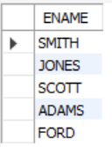
SQL subquery eksempel
Den indre subquery udføres først
Giver dette resultat
Output i subquery substitueres i ydre query resultat
Ved eksekvering fås dette resultat
Notes:
https://www.guru99.com/sub-queries.html

Slide 5
SQL join
Join henter data fra flere tabeller
Tabellerne er relateret med primær og fremmednøgle.
Notes:
https://www.guru99.com/sub-queries.html

Slide 6
SQL cross join
select * from emp, dept
dept
emp
dept
emp
cross join
Alle rækker fra begge tabeller
Notes:
https://www.guru99.com/sub-queries.html

Slide 7
SQL inner join
select * from emp, dept
where emp.deptno = dept.deptno
dept
emp
dept
emp
inner join
Kun matchende rækker
Notes:
https://www.guru99.com/sub-queries.html

Slide 8
SQL inner join variant 2
select ename, job from emp
inner join dept using (deptno)
dept
emp
dept
emp
inner join
Kun matchende rækker
Notes:
https://www.guru99.com/sub-queries.html

Slide 9
SQL inner join variant 3
select ename, job from emp
inner join dept on dept.deptno
= emp.deptno
dept
emp
dept
emp
inner join
Kun matchende rækker
Notes:
https://www.guru99.com/sub-queries.html

Slide 10
SQL left join
SELECT * FROM zipcodes left join customers
ON zipcodes.zip = customers.zip;
customers
zipcodes
customers
zipcodes
left join
Alle rækker fra venstre tabel
Notes:
https://www.guru99.com/sub-queries.html

Slide 11
SQL right join
SELECT ename, ono FROM orders right join employees on orders.eno = employees.eno
employees
orders
employees
orders
right join
Alle rækker fra højre tabel
Notes:
https://www.guru99.com/sub-queries.html

